Slide 1
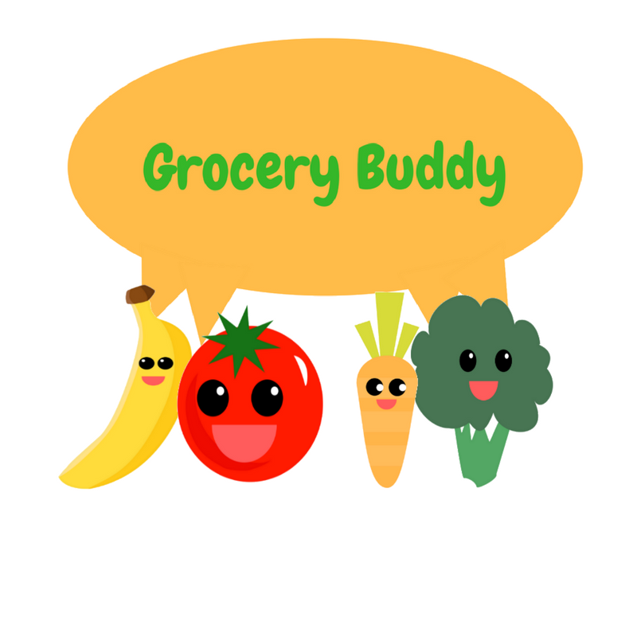
Project Summary
By Ecoders (Carlo, Raly, Toni, Kevin, and Patrick)
Notes:
Kevin

Slide 2

Problem Statement
Food waste can be prevented with thorough planning and tracking.
Notes:
Toni
As you all know, food waste is food that could have been eaten but was thrown away or composted instead.
1/3 of food produced in Canada is wasted.
47% of which is due to consumers.
The preferred method of reducing food waste of course starts with source reduction.
Which means reducing the volume of surplus of food generated and of course that starts with the individual.
Ie: have a shopping list when you go to the grocery store, know what you already have in the fridge so you don’t overbuy during your next grocery shop.

Slide 3

Project Goals & Objective
Grocery buddy is an app that will enable consumers to:
Plan their grocery lists and track the expiration dates of perishable food items
Users will be able to make the most out of their food purchases.
Notes:
Raly
________________________________________________________________________
Make grocery lists
Check items off as you get them
Save lists for future use
Move purchased items into a virtual “fridge”
See which foods are closest to expiring
Receive notifications when food is expiring (set times for reminders)
_______________________________________________________________________
Presentation Notes
So, you might be wondering what are our goals and objectives.
It all comes back to the idea of making an impact in food waste reduction, while keeping things simple so that it never feels like it’s a chore for the user.
Making a grocery list of what you need might be easy, but keeping track of everything you buy is not.
Our app integrates an expiration tracker with the user’s shopping list to help you keep track of the shelf-life of your perishable food items. User experience is important to us, and we plan to focus on making the app both convenient and intuitive so that you can plan your grocery shopping with ease and make the most out of your food purchases.

Slide 4

Gather Requirements
Intuitively input and manage grocery lists (add, rename, copy, delete).
Automatically transfer items checked off grocery lists into a “fridge” list.
Fetch and track expiration information from database.
Send customizable push notifications to inform users when their food is about to go bad.
Notes:
Patrick
Our baseline requirements:
Database of food items – contains expiration dates and food information
Database of users – contains grocery lists, custom user foods, and a fridge
Database of fridge items – contains food items from user

Slide 5

Deliverables
Sprint #1: Working UI for entering data.
Sprint #2: UI accurately pulls back-end data.
Sprint #3: UI complete, notifications are fully implemented.
Notes:
Carlo
The first sprint will be spent creating and designing our user interface, it will be functional for pulling information from a list
The second sprint will be when we create our database and implement our researched data
The third sprint is where we will have our data in place which we can use to work on creating notifications as well as value-added features

Slide 6

Success Criteria
UI/UX is easy to use, and intuitive for the typical grocery shopper.
App accurately notifies you when food is about to expire.
Notes:
Kevin
In order for our app to be successful, it needs to
Be easy enough for shoppers to use that they will use the grocery list feature
Notify users when food is about to expire
App must be able to pull and store the correct data from server-side

Slide 7
Risks (Ongoing List)
 | Probability | Impact | Mitigation
Overestimate scope | High | High | Identify all necessary functions and technologies during the planning process
Lack of specificity in goals | Medium | High | Clearly state the minimum requirements for goals desired
Miss deadline | Low | High | Use Scrum to track project progress, help team mates with challenging tasks
Fail to use technology correctly | Medium | High | Use familiar technology that supports functionality desired, ask instructors for help
Notes:
Toni
As you can see from the risks, we identified four major factors that hinder project completion: overestimating scope, lack of specificity, missed deadlines, tech failure.
Number one is the most likely, overestimating the scope of the work that we have to do, and how we’re going to prevent that from happening is through
identifying all necessary functions and technologies during the planning process.
We also want to be specific in our goals - we figured without clear cut goals we won’t be getting things done as fast.
Next is missed deadline, this has a very low probability of happening as our team is very on top of everything and we are using SCRUM to track project progress and we help eachother with challenging tasks.
And last but not least, we thought about another factor, failing to use technology correctly, and we plan to avoid this by using familiar technology that gets the job done and ask instructors for help if necessary.

Slide 8
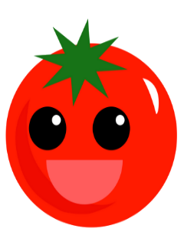
Stakeholders
Our team
Metro Vancouver
CST Faculty
Notes:
Raly
_______________________________________________________________________________________
People who benefit from our project would be:
Us – because we want to get good grades and create a cool app
Metro Vancouver – because we want to help reduce food loss and benefit the city
CST Faculty – because they get to show off our work to other teachers and people in the industry
__________________________________________________________________________________________________
Presentation notes
Now that you we’ve established some of the main risks, the next question is who is affected?
Well, first and foremost, us! We’re taking this opportunity in full stride to really push ourselves to learn more and see just what we can accomplish as a team. And it goes without saying, of course, that we want to get a good mark.
Metro Vancouver! They are also stakeholders because we want to help reduce food waste to lessen the impact on the environment in metro Vancouver.
Finally, you guys! The wonderful BCIT faculty of CST. We want to show what students taught by the professors of CST are capable of, so that it exemplifies the results of your teaching.

Slide 9

Conclusion
Any questions?
Notes:
Patrick

Slide 10
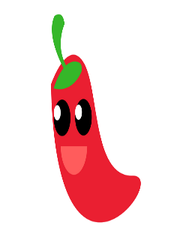
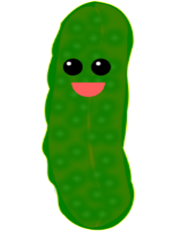

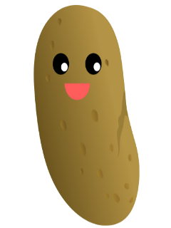

Thanks!
Notes:
Carlo

